Slide 1

Binary Analysis Beyond Decompilers: Emulation, SMT Solving, and Symbolic Execution
Mohamed Jilani Chagra (@m0ud4)
CyberSphere Congress 2026

Slide 2




Who am I ?
Mohamed Jilani Chagra
Cyber Security Engineer @Marquardt GmbH
Detection engineering and managing Microsoft security stack
IoT VR Intern @Toreon BV
Building an automated pipeline for firmware research
CTF player @ARESx
Technical Team Member @SecurinetsTekup
Interested in Reverse engineering and currently exploring embedded and IOT
Find me at discord/X (@m0ud4)

Slide 3
Motivation and Workshop goals
Learn about reverse engineering
Analyze binaries in new ways (beyond decompilers)
Discover new concepts
Build a practical mental model
Learn when emulation and symbolic execution help because we often neglect it (we tend to focus on static and dynamic only)
Develop intuition to learn more about the field and subjects discussed

Slide 4
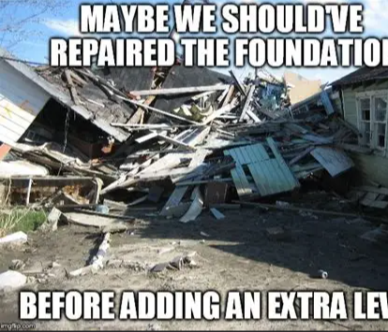
Little Bit of Foundation first !
Before we go deeper, let’s quickly align on the basics. Since the audience has mixed levels, this part is here to build the mental model for what comes next

Slide 5
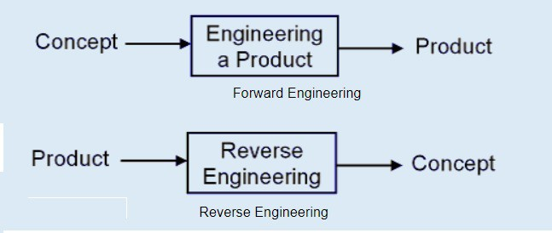
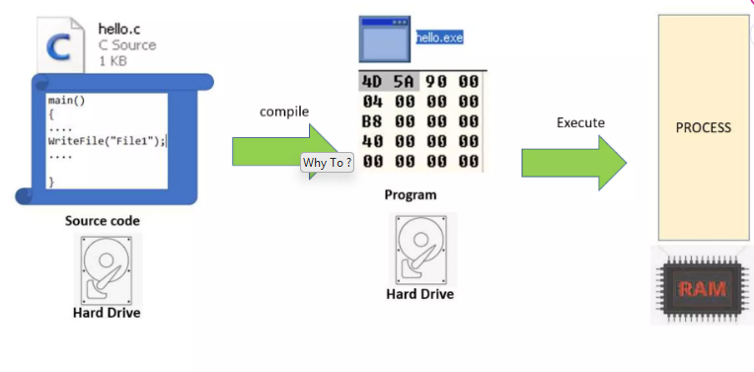
What is reverse engineering ?
Forward Engineering vs Reverse Engineering (Machines, Military, biological genes)
The art of taking something you don’t understand and try to figure how it works
Derive pseudo-code from compiled software
Only Applied on Closed source programs

Slide 6
Why To ?
Fixing vulns
Malware analysis (decryptor, detection engineering…)
Patch analysis
Money (find bugs)
Game cheats
Cracking software

Slide 7
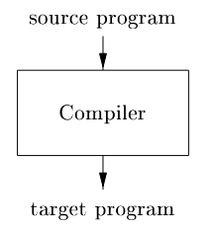
What is a compiler ?
A compiler translates a program in a source language to a program in a target language.
The most well known form of a compiler is one that translates (and improve) a high-level language like C into the native assembly language of a machine so that it can be executed. And of course there are compilers for other languages like C++, Java, C#, and Rust, and many others.

Slide 8
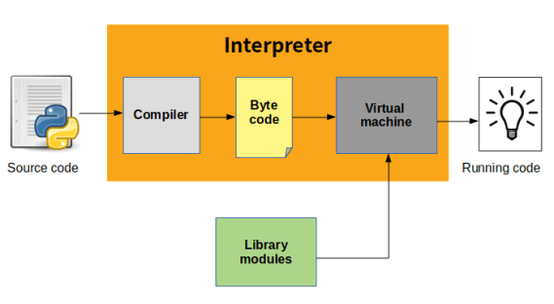
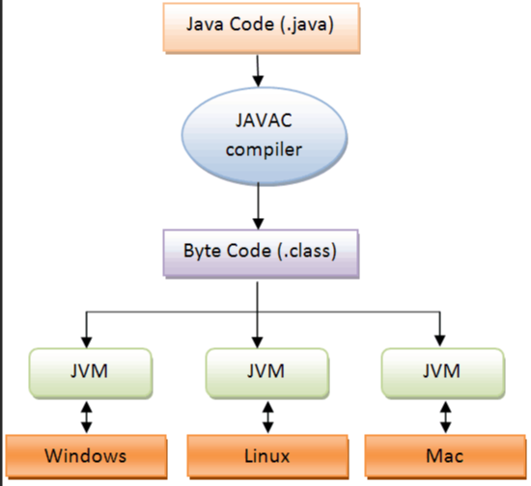
Compiler vs Interpreter
Interpreter reads in a program and then executes it directly without emitting a translation (virtual machine) (python, Ruby..)
Compilers and interpreters are closely related, and it is sometimes possible to exchange one for the other. . For example, Java compilers translate Java source code into Java bytecode, which is an abstract form of assembly language.
Compiled Interpreted languages like Java

Slide 9
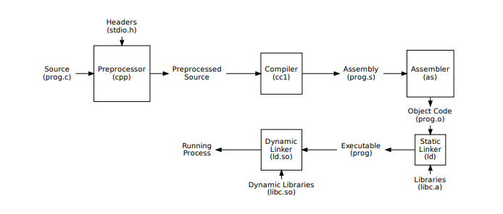
The Compiler Toolchain
A compiler is one component in a toolchain of programs used to create executables from source code

Slide 10
What are we reversing ?
Generally, we will be dealing with:
-Executables (PE) (.exe, .dll, .sys…) windows
-ELF (executable, shared library, object file, core dumps…) Unix
-Mach-O executables
-Bytecode or intermediate language can be reversed too

Slide 11
What is an ELF binary ?
Executable and Linkable Format
The 101 of ELF files on Linux: Understanding and Analysis - Linux Audit

Slide 12
What is an exe (PE) ?
A dive into the PE file format - PE file structure - Part 1: Overview - 0xRick’s Blog
The Windows Portable Executable (PE) File Format - Yuriy Georgiev's corner

Slide 13
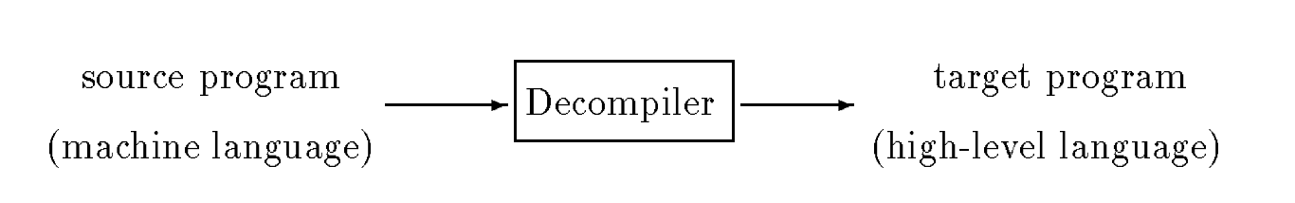
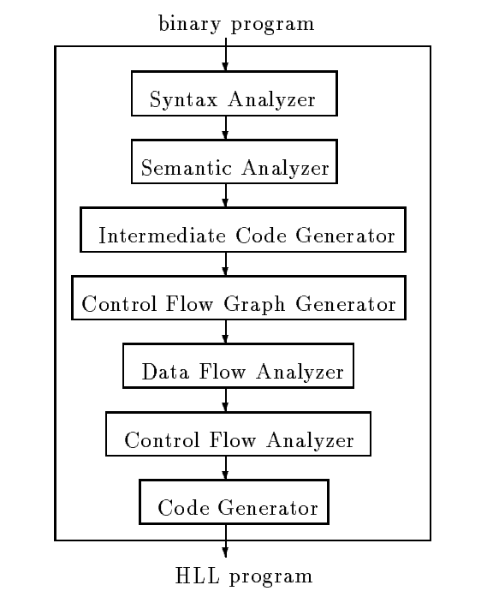
What is a decompiler ? (Reverse Compiler)
A decompiler is a program that reads a program written in a machine language (The source language) and translates it into an equivalent program in a high level language (The target language)

Slide 14
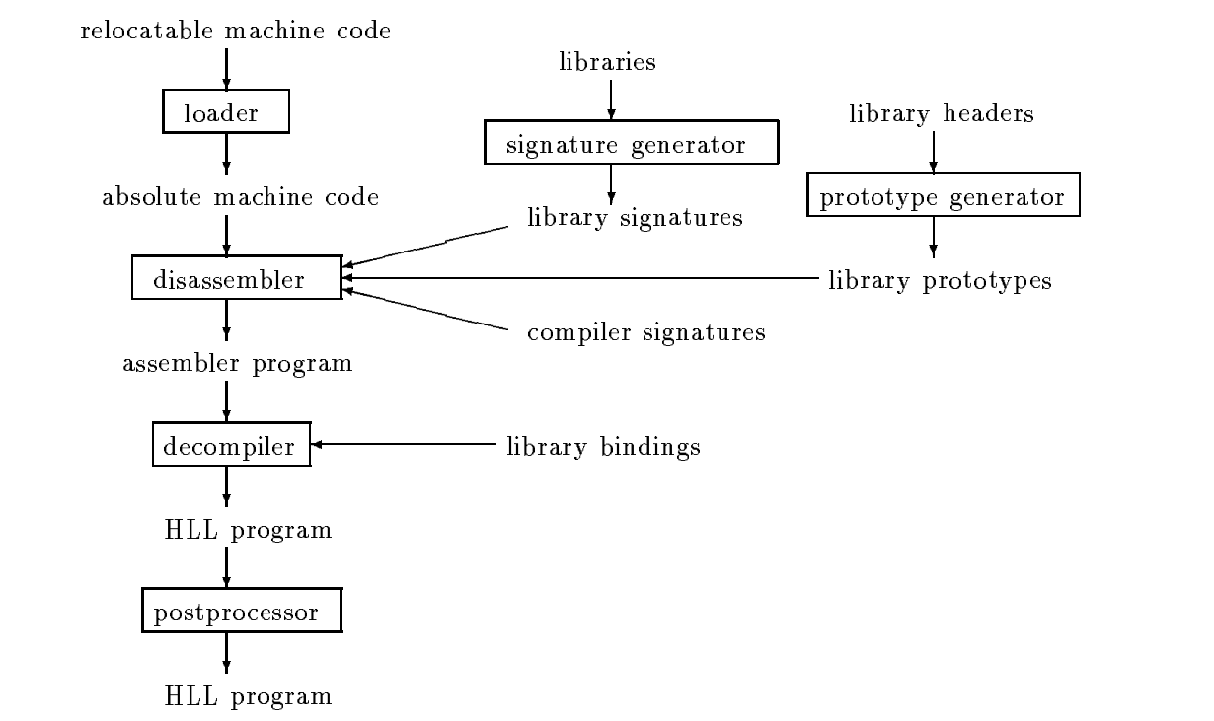
The Decompiler Toolchain
Several programs can be used with the decompiler to create the target high-level language program

Slide 15

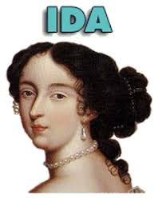

Tools of the trade

Slide 16
What decompilers are good at ?
A decompiler gives us a higher-level hypothesis of what the binary is doing. It reconstructs structure, variables, and control flow into something closer to source code. That is powerful but it’s still reconstruction, not truth.
For many binaries they are enough.

Slide 17
Meet our first binary v1
Open goode-code and put it in your favorite decompiler
Or open it in dogbolt
And inspect what you see

Slide 18
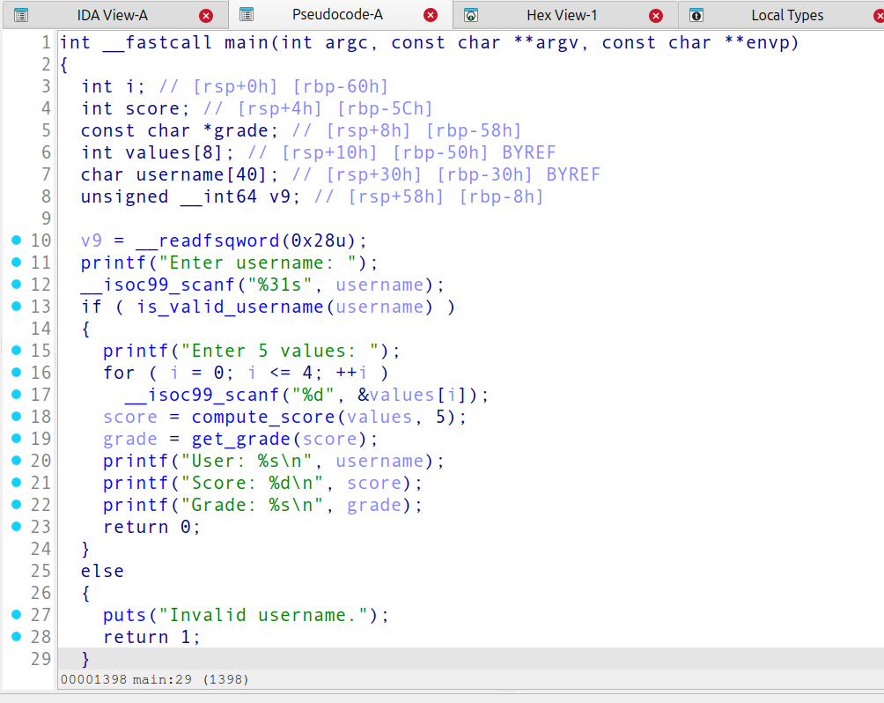
Simple program pseudo code

Slide 19
Simple Program pseudo code
Let's check if we can understand the pseudo-code without checking the source code ourselves.
What about the control-flow ?
What about the values ?

Slide 20
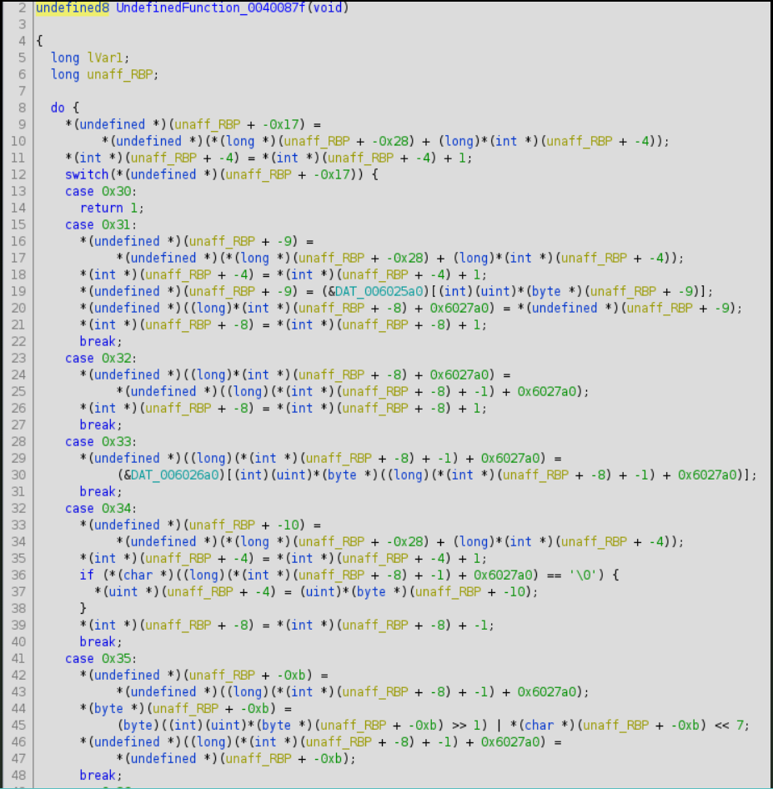
Ugly pseudo-code

Slide 21
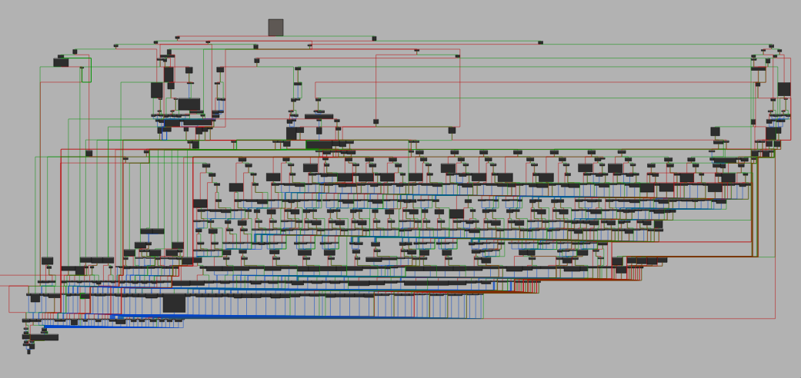
Hard to understand CFG ollvm

Slide 22
Why/When decompilers are not enough ?
Ugly pseudo code
Unclear branching
Values being heavily transformed
Anti-decompilers techniques
Obfuscation/Packing
Compiler optimizations
Indirect branches

Slide 23
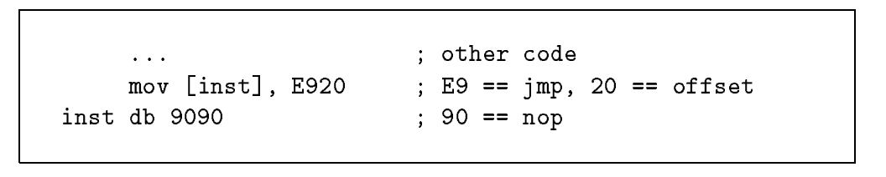
Self Modifying Code
Self-modifying code refers to instructions or preset data that are modified during execution of the program. A memory byte location for an instruction can be modified during program execution to represent another inst or data.

Slide 24
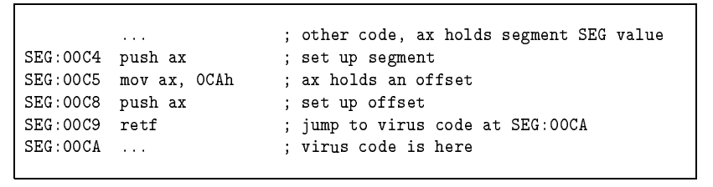
Virus and Trojan ‘Tricks’
Code that stores in the stack a new return address for a procedure, when disassembling code, most disassemblers would stop at the far return instruction believing an end of procedure is met.

Slide 25
What mental model to use ?
Our problem is no longer ‘can I read this to understand what’s happening ?’ it shifts to ‘how do I recover behavior and logic’
What are the parts that matter the most in the program ?
What if I want to just focus on one part of the program without running the rest ?

Slide 26


What is Emulation ?
If the decompiler gives us a guess, emulation lets us ask the binary to demonstrate what it actually does.
With emulation we choose which code emulate and it’s context
Safe way to analyze executables or shellcodes.

Slide 27
Emulation Use Cases
Binary Analysis: Analyzing binary code without executing it on real hardware
Malware Analysis: Safely examining malicious code behavior
Fuzzing: Generating test cases for software testing
Reverse Engineering: Understanding how compiled code works
Emulation: Running code for unsupported or legacy architectures
Security Research: Exploring vulnerabilities and exploits

Slide 28

Meet Unicorn !! (A CPU without an OS)
Not your usual emulator (you can’t emulate a system or a program) (modified version of Qemu)
No syscalls, just CPU instructions
You control every register and byte of memory
You can start from any address and stop anywhere
You can call an interesting function from the malware, without creating a harmfull process
Emulating obfuscated code
Useful for Fuzzing
GitHub - unicorn-engine/unicorn: Unicorn CPU emulator framework (ARM, AArch64, M68K, Mips, Sparc, PowerPC, RiscV, S390x, TriCore, X86) · GitHub

Slide 29
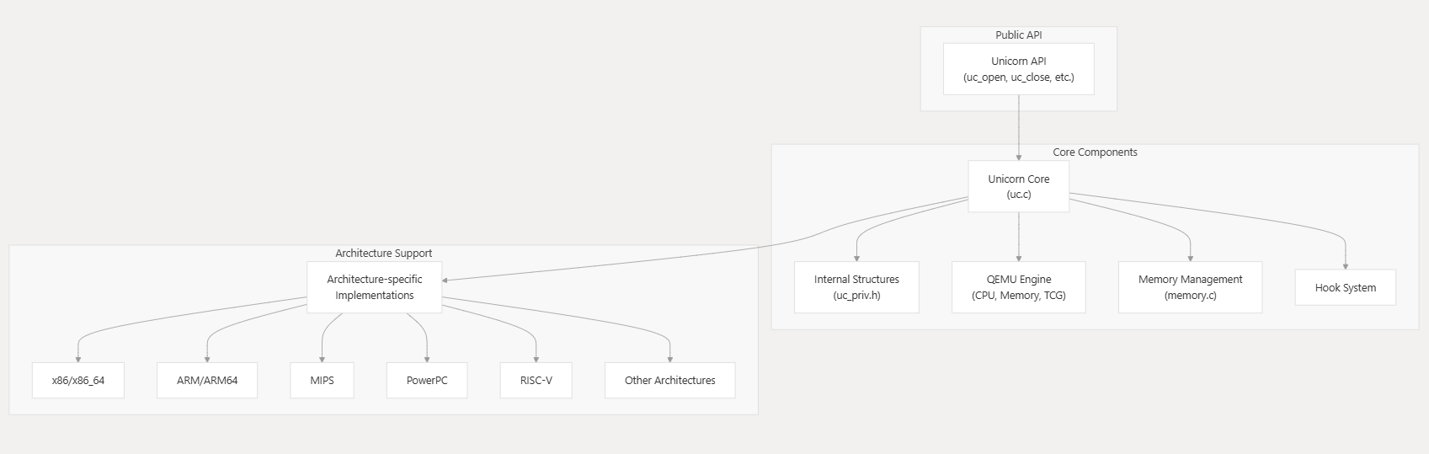
Unicorn Core Architecture

Slide 30
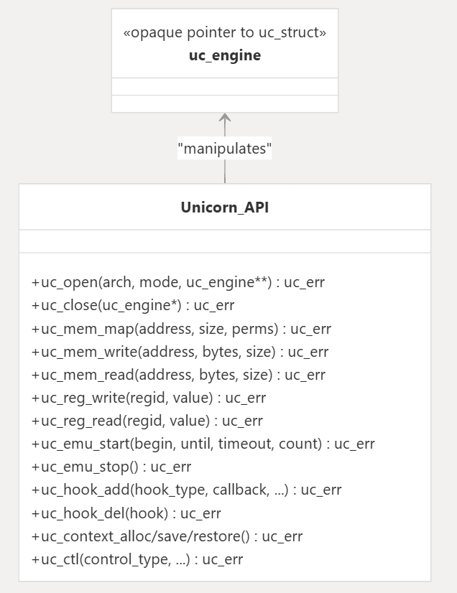
Unicorn API map

Slide 31
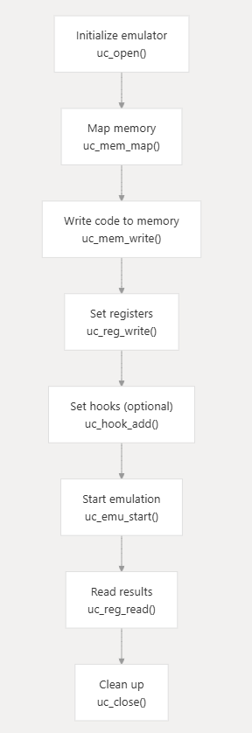
Emulation Workflow

Slide 32
Get your env ready !

Slide 33
Demo1: Hello Emulation

Slide 34
Exercise 1: xor lab get your flag

Slide 35
Real World implementation
Palo Alto Unit42 used this exact pattern to decode Hancitor malware C2 servers, they ran the attacker's own decode function inside Unicorn, read the plaintext output. No reimplementing the algorithm. No running the malware. Just emulating the function, they already wrote.
Pythons and Unicorns and Hancitor…Oh My! Decoding Binaries Through Emulation

Slide 36
What mental model to use ?
Emulation is great when I want to execute a specific function and observe what it does.
But sometimes running the code is not enough. I may understand the validation logic, yet I still do not know which input satisfies it.
So now the question changes again: not “what does this code do?” but “what input makes this code succeed?”

Slide 37
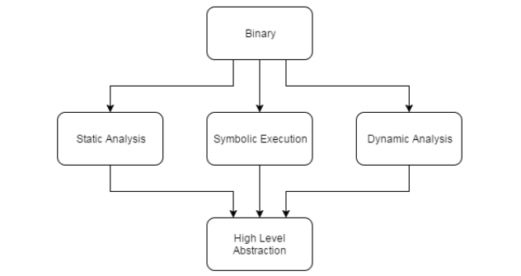
A binary can be seen in three ways
Reverse engineering concept diagram:
Static analysis
Symbolic execution (in-between)
Dynamic analysis

Slide 38
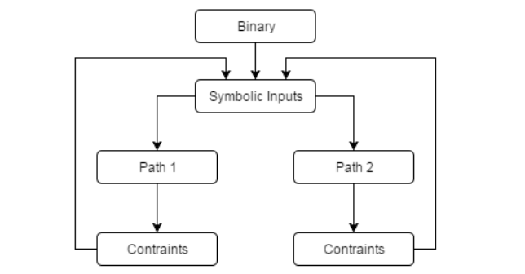
Symbolic Execution
A program analysis technique used to explore multiple execution paths of a program simultaneously
Unlike normal execution, which runs the program with specific inputs, symbolic execution treats inputs as symbolic variables rather than concrete values

Slide 39
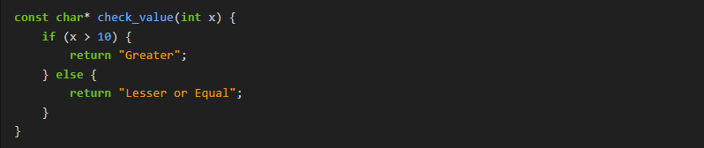
Example 1 (Branching)
Concrete execution
Symbolic execution

Slide 40
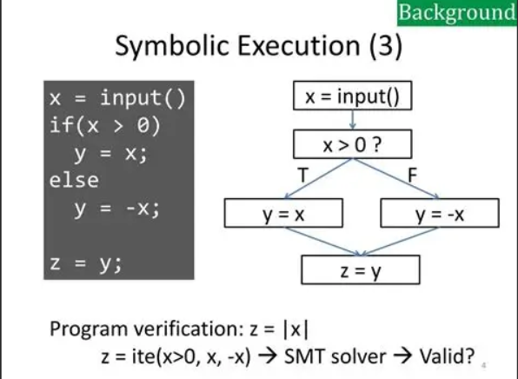

Slide 41
Problem ?
Path Explosion
Symbolic execution is powerful but at some point it needs to actually answer a question. When we've explored a path and accumulated all the conditions the input must satisfy, we still need something to solve them.
That's where SMT solvers come in. Symbolic execution produces the constraints. Z3 solves them. They're not competing tools one feeds the other Symbolic Execution needs a solver

Slide 42
SMT
Satisfiability Modulo Theories are one of the most interesting topics to learn about in computer science.
They can reduce a big chunk of time that would be spent on statically or dynamically analyzing the binary
They do the magic
But they have limits…
Z3 is an SMT sovler

Slide 43
SAT Solvers
Boolean Satisfiability Problem solvers (something about Booleans ?)
Boolean expression as input and output possible values either returning True (SAT) or False (UNSAT)
SMT solvers are built on top of SAT solvers (backend)

Slide 44

Z3
A theorem prover/SMT solver from Microsoft Research.
If a problem can be expressed as a system of equations/inequalities z3 can try and find a solution.

Slide 45
Z3 Demo !
Open z3_workshop.ipynb

Slide 46
What’s next?
Today we discovered a lot of new cool concepts, now you need to complete the journey yourself and read more about it
Try to use these concepts in real world examples
Read about angr a framework that combines emulation and symbolic execution

Slide 47

Recap

Slide 48

Thank you !

